Slide 1
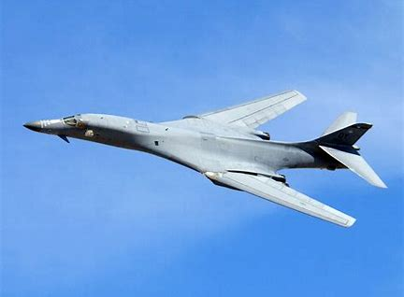
B-1 Lancer

Slide 2
Circuit Card Assembly: AS - Repair Robins AFB – 410th SCMS
MD: | B-1
TMS: | N/A
Noun: | Circuit Card Assembly
NSN: | 5998-01-193-4223
P/N: | 865284-1
Forecasted Buy Price: | $14,254.74
Forecasted Repair Cost: | $10,690.52
AAC: | V
Unserv. Assets Avail: | No
QPA/APPL Rate: | 1 | 100%
AMC/AMSC: | Not Available | Not Available
RMC/RMSC: | Not Available | Not Available
Material: | Not Available
Dimensions: | Not Available
Criticality Code: | X
Drawings Releasable: | Yes
Drawing #: | 865284
Drawing Cage Code: | 20418
T.O. Releasable: | Yes
T.O. #: | 33D7-59-64-4/33D7-59-64-1
Budget Code: | 8
Next Higher Asmbly: | AN/USM-305 DATSA
Out Year Requirements: BUY
FY24: | 0 | FY25: | 0 | FY26: | 0 | FY27: | 0 | FY28: | 0
Out Year Requirements: REPAIR
FY24: | 2 | FY25: | 2 | FY26: | 1 | FY27: | 1 | FY28: | 1
EDL: | Not Available |  |  |  |  | RDL: | Available
Tinker | 8/10/2023 |  |  |  |  | Robins | 3/24/2023
Hill | 12/8/2022 |  |  |  |  | Virtual | ------
Comments
Produces seven individually programmable DC reference voltages which are applied through reference supply to establish upper and lower logic levels for the digital stimulus test pattern applied to the UUT
Deliverables: Source Approval Request (SAR) Package **NOTE** - SAR package can be combined with item for NSN 5998-01-275-4719
NOTE: Send notification to 429SCMS.SASPO.Workflow@us.af.mil within 45 days of intent to submit SAR package

Slide 3
Circuit Card Assembly: AS - Repair Robins AFB – 410th SCMS
MD: | B-1
TMS: | N/A
Noun: | Circuit Card Assembly
NSN: | 5998-01-193-4225
P/N: | 865274-301
Forecasted Buy Price: | $10,508.58
Forecasted Repair Cost: | $5,995.36
AAC: | V
Unserv. Assets Avail: | No
QPA/APPL Rate: | 1 | 100%
AMC/AMSC: | 3 | H
RMC/RMSC: | 5 | R
Material: | Not Available
Dimensions: | Not Available
Criticality Code: | Y
Drawings Releasable: | Yes
Drawing #: | 865274
Drawing Cage Code: | 20418
T.O. Releasable: | Yes
T.O. #: | 33D7-59-64-4/33D7-59-64-1
Budget Code: | 8
Next Higher Asmbly: | AN/USM-305 DATSA
Out Year Requirements: BUY
FY24: | 0 | FY25: | 0 | FY26: | 0 | FY27: | 0 | FY28: | 0
Out Year Requirements: REPAIR
FY24: | 3 | FY25: | 3 | FY26: | 3 | FY27: | 3 | FY28: | 3
EDL: | Not Available |  |  |  |  | RDL: | Not Available
Tinker | 8/10/2023 |  |  |  |  | Robins | 3/24/2023
Hill | 12/8/2022 |  |  |  |  | Virtual | ------
Comments
A35 Digital Word Generator RAM Circuit Card Assembly provides 512K bytes of temporary storage memory used by CPU to store pattern and error data.
Deliverables: Source Approval Request (SAR) Package. Please send a request to randy.miller.22@us.af.mil and include your email address and “request a drop off”. A “request for drop off” will be returned, use this to submit your SAR package.
NOTE: Send notification to 429SCMS.SASPO.Workflow@us.af.mil within 45 days of intent to submit SAR package.

Slide 4
Circuit Card Assembly: AS - Repair Robins AFB – 410th SCMS
MD: | B-1
TMS: | N/A
Noun: | Circuit Card Assembly
NSN: | 5998-01-275-4719
P/N: | 865284-301
Forecasted Buy Price: | $8,909.21
Forecasted Repair Cost: | $6,681.58
AAC: | V
Unserv. Assets Avail: | No
QPA/APPL Rate: | 1 | 100%
AMC/AMSC: | Not Available | Not Available
RMC/RMSC: | 2 | R
Material: | Not Available
Dimensions: | Not Available
Criticality Code: | Y
Drawings Releasable: | Yes
Drawing #: | 865284
Drawing Cage Code: | 20418
T.O. Releasable: | Yes
T.O. #: | 33D7-59-64-4/33D7-59-64-1
Budget Code: | 8
Next Higher Asmbly: | AN/USM-305 DATSA
Out Year Requirements: BUY
FY24: | 0 | FY25: | 0 | FY26: | 0 | FY27: | 0 | FY28: | 0
Out Year Requirements: REPAIR
FY24: | 2 | FY25: | 2 | FY26: | 1 | FY27: | 1 | FY28: | 1
EDL: | Not Available |  |  |  |  | RDL: | Available
Tinker | 8/10/2023 |  |  |  |  | Robins | 3/24/2023
Hill | 12/8/2022 |  |  |  |  | Virtual | ------
Comments
Produces seven individually programmable DC reference voltages which are applied through reference supply to establish upper and lower logic levels for the digital stimulus test pattern applied to the UUT.
Deliverables: Source Approval Request (SAR) Package. Please send a request to randy.miller.22@us.af.mil and include your email address and “request a drop off”. A “request for drop off” will be returned, use this to submit your SAR package.
NOTE: Send notification to 429SCMS.SASPO.Workflow@us.af.mil within 45 days of intent to submit SAR package.

Slide 5
Circuit Card Assembly: AS - Repair Robins AFB – 410th SCMS
MD: | B-1
TMS: | N/A
Noun: | Circuit Card Assembly
NSN: | 5998-01-275-5767
P/N: | 866720
Forecasted Buy Price: | $5,955.21
Forecasted Repair Cost: | $4,466.18
AAC: | V
Unserv. Assets Avail: | No
QPA/APPL Rate: | 1 | 100%
AMC/AMSC: | Not Available | Not Available
RMC/RMSC: | 2 | R
Material: | Not Available
Dimensions: | Not Available
Criticality Code: | Y
Drawings Releasable: | Yes
Drawing #: | 866720
Drawing Cage Code: | 20418
T.O. Releasable: | Yes
T.O. #: | 33D7-59-64-4/33D7-59-64-1
Budget Code: | 8
Next Higher Asmbly: | AN/USM-305 DATSA
Out Year Requirements: BUY
FY24: | 0 | FY25: | 0 | FY26: | 0 | FY27: | 0 | FY28: | 0
Out Year Requirements: REPAIR
FY24: | 2 | FY25: | 2 | FY26: | 1 | FY27: | 1 | FY28: | 1
EDL: | Not Available |  |  |  |  | RDL: | Available
Tinker | 8/10/2023 |  |  |  |  | Robins | 3/24/2023
Hill | 12/8/2022 |  |  |  |  | Virtual | ------
Comments
Contains the firmware routines necessary for the CPU to interpret and execute CIIL programmed messages.
Deliverables: Source Approval Request (SAR) Package. Please send a request to randy.miller.22@us.af.mil and include your email address and “request a drop off”. A “request for drop off” will be returned, use this to submit your SAR package.
NOTE: Send notification to 429SCMS.SASPO.Workflow@us.af.mil within 45 days of intent to submit SAR package.

Slide 6
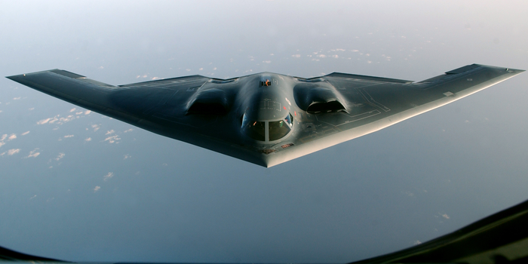
B-2

Slide 7
Hose Assy, Non-metallic: AS-New Buy Tinker AFB – 424th SCMS
MD: | B-2
TMS: | N/A
Noun: | Hose Assy, Non-metallic
NSN: | 4720-01-362-3480
P/N: | DAA3515A010-009
Forecasted Buy Price: | $2,176.77
Forecasted Repair Cost: | N/A
AAC: | Z
Unserv. Assets Avail: | No
QPA/APPL Rate: | 1 | 100%
AMC/AMSC: | 3 | D
RMC/RMSC: | Not Available | Not Available
Material: | Rubber, Fluorosilicone Elastomer
Dimensions: | Not Available
Criticality Code: | X
Drawings Releasable: | Yes
Drawing #: | DAA3515P010 (Performance Spec)
Drawing Cage Code: | 81205
T.O. Releasable: | No
T.O. #: | Not Available
Budget Code: | 9
Next Higher Asmbly: | Not Available
Out Year Requirements: BUY
FY24: | 10-15 | FY25: | 0 | FY26: | 0 | FY27: | 0 | FY28: | 0
Out Year Requirements: REPAIR
FY24: | 0 | FY25: | 0 | FY26: | 0 | FY27: | 0 | FY28: | 0
EDL: | Not Available |  |  |  |  | RDL: | Not Available
Tinker | 08/10/2023 |  |  |  |  | Robins | 03/24/2023
Hill | ------ |  |  |  |  | Virtual | ------
Comments
Deliverables: All eight hose assemblies can be on a single SAR package.
Interested vendors should submit a Source Approval Request (SAR) to dlaavnsmallbus@dla.mil
Flex Fab owns drawings
NOTE: Send notification to 429SCMS.SASPO.Workflow@us.af.mil within 45 days of intent to submit SAR package.

Slide 8
Hose Assy, Non-metallic: AS-New Buy Tinker AFB – 424th SCMS
MD: | B-2
TMS: | N/A
Noun: | Hose Assy, Non-metallic
NSN: | 4720-01-362-3481
P/N: | DAA3515A011-017
Forecasted Buy Price: | $1,161.45
Forecasted Repair Cost: | N/A
AAC: | Z
Unserv. Assets Avail: | No
QPA/APPL Rate: | 1 | 100%
AMC/AMSC: | 4 | P
RMC/RMSC: | Not Available | Not Available
Material: | Rubber, Fluorosilicone Elastomer
Dimensions: | Not Available
Criticality Code: | X
Drawings Releasable: | Yes
Drawing #: | DAA3515P010 (Performance Spec)
Drawing Cage Code: | 81205
T.O. Releasable: | No
T.O. #: | Not Available
Budget Code: | 9
Next Higher Asmbly: | Not Available
Out Year Requirements: BUY
FY24: | 10-15 | FY25: | 0 | FY26: | 0 | FY27: | 0 | FY28: | 0
Out Year Requirements: REPAIR
FY24: | 0 | FY25: | 0 | FY26: | 0 | FY27: | 0 | FY28: | 0
EDL: | Not Available |  |  |  |  | RDL: | Not Available
Tinker | 08/10/2023 |  |  |  |  | Robins | 03/24/2023
Hill | ------ |  |  |  |  | Virtual | ------
Comments
Deliverables: All eight hose assemblies can be on a single SAR package.
Interested vendors should submit a Source Approval Request (SAR) to dlaavnsmallbus@dla.mil
Flex Fab owns drawings
NOTE: Send notification to 429SCMS.SASPO.Workflow@us.af.mil within 45 days of intent to submit SAR package.

Slide 9
Hose Assy, Non-metallic: AS-New Buy Tinker AFB – 424th SCMS
MD: | B-2
TMS: | N/A
Noun: | Hose Assy, Non-metallic
NSN: | 4720-01-362-3482
P/N: | DAA3515A011-019
Forecasted Buy Price: | $ 325.59
Forecasted Repair Cost: | N/A
AAC: | D
Unserv. Assets Avail: | No
QPA/APPL Rate: | 1 | 100%
AMC/AMSC: | 3 | P
RMC/RMSC: | Not Available | Not Available
Material: | Rubber, Fluorosilicone Elastomer
Dimensions: | Not Available
Criticality Code: | X
Drawings Releasable: | Yes
Drawing #: | DAA3515P010 (Performance Spec)
Drawing Cage Code: | 81205
T.O. Releasable: | No
T.O. #: | Not Available
Budget Code: | 9
Next Higher Asmbly: | Not Available
Out Year Requirements: BUY
FY24: | 10-15 | FY25: | 0 | FY26: | 0 | FY27: | 0 | FY28: | 0
Out Year Requirements: REPAIR
FY24: | 0 | FY25: | 0 | FY26: | 0 | FY27: | 0 | FY28: | 0
EDL: | Not Available |  |  |  |  | RDL: | Not Available
Tinker | 08/10/2023 |  |  |  |  | Robins | 03/24/2023
Hill | ------ |  |  |  |  | Virtual | ------
Comments
Deliverables: All eight hose assemblies can be on a single SAR package.
Interested vendors should submit a Source Approval Request (SAR) to dlaavnsmallbus@dla.mil
Flex Fab owns drawings
NOTE: Send notification to 429SCMS.SASPO.Workflow@us.af.mil within 45 days of intent to submit SAR package.

Slide 10
Hose Assy, Non-metallic: AS-New Buy Tinker AFB – 424th SCMS
MD: | B-2
TMS: | N/A
Noun: | Hose Assy, Non-metallic
NSN: | 4720-01-362-3483
P/N: | DAA3515A012-017
Forecasted Buy Price: | $1,524.36
Forecasted Repair Cost: | N/A
AAC: | Z
Unserv. Assets Avail: | No
QPA/APPL Rate: | 1 | 100%
AMC/AMSC: | 4 | P
RMC/RMSC: | Not Available | Not Available
Material: | Rubber, Fluorosilicone Elastomer
Dimensions: | Not Available
Criticality Code: | X
Drawings Releasable: | Yes
Drawing #: | DAA3515P010 (Performance Spec)
Drawing Cage Code: | 81205
T.O. Releasable: | No
T.O. #: | Not Available
Budget Code: | 9
Next Higher Asmbly: | Not Available
Out Year Requirements: BUY
FY24: | 10-15 | FY25: | 0 | FY26: | 0 | FY27: | 0 | FY28: | 0
Out Year Requirements: REPAIR
FY24: | 0 | FY25: | 0 | FY26: | 0 | FY27: | 0 | FY28: | 0
EDL: | Not Available |  |  |  |  | RDL: | Not Available
Tinker | 08/10/2023 |  |  |  |  | Robins | 03/24/2023
Hill | ------ |  |  |  |  | Virtual | ------
Comments
Deliverables: All eight hose assemblies can be on a single SAR package.
Interested vendors should submit a Source Approval Request (SAR) to dlaavnsmallbus@dla.mil
Flex Fab owns drawings
NOTE: Send notification to 429SCMS.SASPO.Workflow@us.af.mil within 45 days of intent to submit SAR package.

Slide 11
Hose Assy, Non-metallic: AS-New Buy Tinker AFB – 424th SCMS
MD: | B-2
TMS: | N/A
Noun: | Hose Assy, Non-metallic
NSN: | 4720-01-362-5654
P/N: | DAA3515A012-019
Forecasted Buy Price: | $1,465.28
Forecasted Repair Cost: | N/A
AAC: | Z
Unserv. Assets Avail: | No
QPA/APPL Rate: | 1 | 100%
AMC/AMSC: | 3 | Q
RMC/RMSC: | Not Available | Not Available
Material: | Rubber, Fluorosilicone, Elastomer
Dimensions: | Not Available
Criticality Code: | X
Drawings Releasable: | Yes
Drawing #: | DAA3515P010 (Performance Spec)
Drawing Cage Code: | 81205
T.O. Releasable: | No
T.O. #: | Not Available
Budget Code: | 9
Next Higher Asmbly: | Not Available
Out Year Requirements: BUY
FY24: | 10-15 | FY25: | 0 | FY26: | 0 | FY27: | 0 | FY28: | 0
Out Year Requirements: REPAIR
FY24: | 0 | FY25: | 0 | FY26: | 0 | FY27: | 0 | FY28: | 0
EDL: | Not Available |  |  |  |  | RDL: | Not Available
Tinker | 08/10/2023 |  |  |  |  | Robins | 03/24/2023
Hill | ------ |  |  |  |  | Virtual | ------
Comments
Deliverables: All eight hose assemblies can be on a single SAR package.
Interested vendors should submit a Source Approval Request (SAR) to dlaavnsmallbus@dla.mil
Flex Fab owns drawings
NOTE: Send notification to 429SCMS.SASPO.Workflow@us.af.mil within 45 days of intent to submit SAR package.

Slide 12
Hose Assy, Non-metallic: AS-New Buy Tinker AFB – 424th SCMS
MD: | B-2
TMS: | N/A
Noun: | Hose Assy, Non-metallic
NSN: | 4720-01-362-5655
P/N: | DAA3515A013-017
Forecasted Buy Price: | $2,257.24
Forecasted Repair Cost: | N/A
AAC: | Z
Unserv. Assets Avail: | No
QPA/APPL Rate: | 1 | 100%
AMC/AMSC: | 3 | P
RMC/RMSC: | Not Available | Not Available
Material: | Rubber, Fluorosilicone Elastomer
Dimensions: | Not Available
Criticality Code: | X
Drawings Releasable: | Yes
Drawing #: | DAA3515P010 (Performance Spec)
Drawing Cage Code: | 81205
T.O. Releasable: | No
T.O. #: | Not Available
Budget Code: | 9
Next Higher Asmbly: | Not Available
Out Year Requirements: BUY
FY24: | 10-15 | FY25: | 0 | FY26: | 0 | FY27: | 0 | FY28: | 0
Out Year Requirements: REPAIR
FY24: | 0 | FY25: | 0 | FY26: | 0 | FY27: | 0 | FY28: | 0
EDL: | Not Available |  |  |  |  | RDL: | Not Available
Tinker | 08/10/2023 |  |  |  |  | Robins | 03/24/2023
Hill | ------ |  |  |  |  | Virtual | ------
Comments
Deliverables: All eight hose assemblies can be on a single SAR package.
Interested vendors should submit a Source Approval Request (SAR) to dlaavnsmallbus@dla.mil
Flex Fab owns drawings
NOTE: Send notification to 429SCMS.SASPO.Workflow@us.af.mil within 45 days of intent to submit SAR package.

Slide 13
Hose Assy, Non-metallic: AS-New Buy Tinker AFB – 424th SCMS
MD: | B-2
TMS: | N/A
Noun: | Hose Assy, Non-metallic
NSN: | 4720-01-362-5656
P/N: | DAA3515A013-019
Forecasted Buy Price: | $1,826.20
Forecasted Repair Cost: | N/A
AAC: | D
Unserv. Assets Avail: | No
QPA/APPL Rate: | 1 | 100%
AMC/AMSC: | 3 | H
RMC/RMSC: | Not Available | Not Available
Material: | Rubber, Fluorosilicone Elastomer
Dimensions: | Not Available
Criticality Code: | X
Drawings Releasable: | Yes
Drawing #: | DAA3515P010 (Performance Spec)
Drawing Cage Code: | 81205
T.O. Releasable: | No
T.O. #: | Not Available
Budget Code: | 9
Next Higher Asmbly: | Not Available
Out Year Requirements: BUY
FY24: | 10-15 | FY25: | 0 | FY26: | 0 | FY27: | 0 | FY28: | 0
Out Year Requirements: REPAIR
FY24: | 0 | FY25: | 0 | FY26: | 0 | FY27: | 0 | FY28: | 0
EDL: | Not Available |  |  |  |  | RDL: | Not Available
Tinker | 08/10/2023 |  |  |  |  | Robins | 03/24/2023
Hill | ------ |  |  |  |  | Virtual | ------
Comments
Deliverables: All eight hose assemblies can be on a single SAR package.
Interested vendors should submit a Source Approval Request (SAR) to dlaavnsmallbus@dla.mil
Flex Fab owns drawings
NOTE: Send notification to 429SCMS.SASPO.Workflow@us.af.mil within 45 days of intent to submit SAR package.

Slide 14
Hose Assy, Non-metallic: AS-New Buy Tinker AFB – 424th SCMS
MD: | B-2
TMS: | N/A
Noun: | Hose Assy, Non-metallic
NSN: | 4720-01-362-5657
P/N: | DAA3515A014-009
Forecasted Buy Price: | $2,456.16
Forecasted Repair Cost: | N/A
AAC: | J
Unserv. Assets Avail: | No
QPA/APPL Rate: | 1 | 100%
AMC/AMSC: | 3 | H
RMC/RMSC: | Not Available | Not Available
Material: | Rubber, Fluorosilicone Elastomer
Dimensions: | Not Available
Criticality Code: | X
Drawings Releasable: | Yes
Drawing #: | DAA3515P010 (Performance Spec)
Drawing Cage Code: | 81205
T.O. Releasable: | No
T.O. #: | Not Available
Budget Code: | 9
Next Higher Asmbly: | Not Available
Out Year Requirements: BUY
FY24: | 10-15 | FY25: | 0 | FY26: | 0 | FY27: | 0 | FY28: | 0
Out Year Requirements: REPAIR
FY24: | 0 | FY25: | 0 | FY26: | 0 | FY27: | 0 | FY28: | 0
EDL: | Not Available |  |  |  |  | RDL: | Not Available
Tinker | 08/10/2023 |  |  |  |  | Robins | 03/24/2023
Hill | ------ |  |  |  |  | Virtual | ------
Comments
Deliverables: All eight hose assemblies can be on a single SAR package.
Interested vendors should submit a Source Approval Request (SAR) to dlaavnsmallbus@dla.mil
Flex Fab owns drawings
NOTE: Send notification to 429SCMS.SASPO.Workflow@us.af.mil within 45 days of intent to submit SAR package.

Slide 15
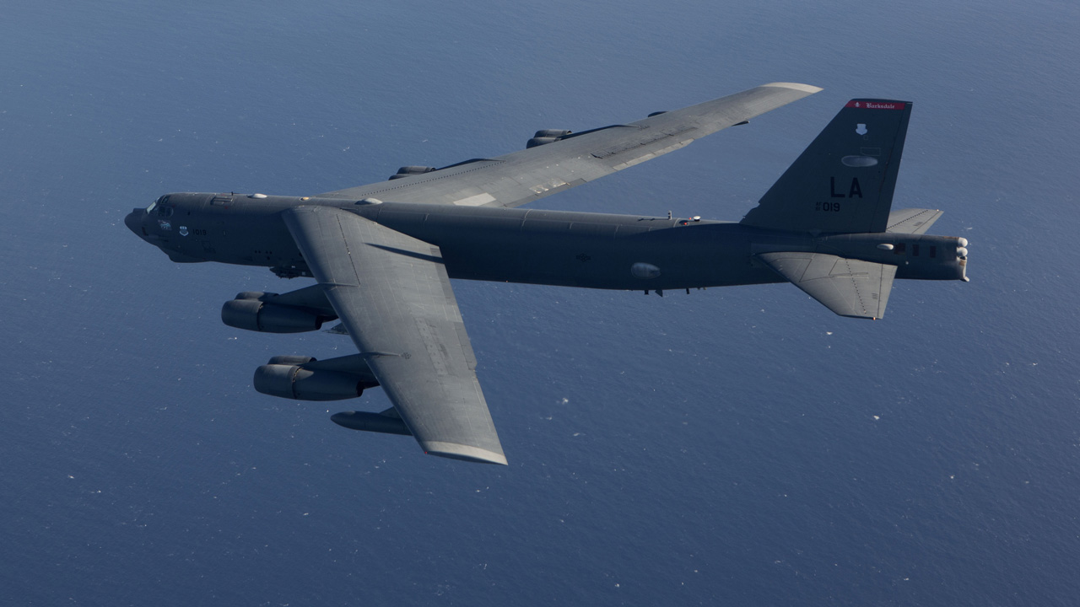
B-52H Bomber

Slide 16
Potentiometer: Reverse Engineering-OTA Tinker AFB – 422nd SCMS
MD: | B-52 / KC-135
TMS: | N/A
Noun: | Potentiometer
NSN: | 5905-01-102-2642 (INACTIVE)
P/N: | P8-5
Forecasted Buy Price: | N/A
Forecasted Repair Cost: | N/A
AAC: | Not Available
Unserv. Assets Avail: | Yes
QPA/APPL Rate: | Not Available | Not Available
AMC/AMSC: | Not Available | Not Available
RMC/RMSC: | Not Available | Not Available
Material: | Not Available
Dimensions: | Not Available
Criticality Code: | Not Available
Drawings Releasable: | Yes
Drawing #: | P8-5
Drawing Cage Code: | 97896
T.O. Releasable: | Yes
T.O. #: | 15H6-2-8-3, Fig. 2-1/2-2
Budget Code: | 9
Next Higher Asmbly: | Cabin Temp Selector
Out Year Requirements: BUY
FY24: | 24 | FY25: | 6 | FY26: | 6 | FY27: | 6 | FY28: | 6
Out Year Requirements: REPAIR
FY24: | 0 | FY25: | 0 | FY26: | 0 | FY27: | 0 | FY28: | 0
EDL: | Not Available |  |  |  |  | RDL: | Not Available
Tinker | 8/10/2023 |  |  |  |  | Robins | ------
Hill | ------ |  |  |  |  | Virtual | ------
Comments
Deliverables: Complete Data Package, 3 functioning prototypes, F3I Replacement
Interested vendors should submit a White Paper to 429SCMS.SASPO.Workflow@us.af.mil

Slide 17
Potentiometer: Reverse Engineering-OTA Tinker AFB – 422nd SCMS
Additional Comments
Potentiometer P/N P8-5 is needed for use in NHA PN: P8-1A Cabin Temperature Selector for both the B-52 and KC-135. PN P8-5 has not been procured since 1980 and has seen an increased failure rate over the past decade or so.
If you would like to participate in the Technical Discussion on:
September 7, 2023, 1:00PM-2:00PM CDT
provide the following, NLT
August 30, 2023
429SCMS.SASPO.Workflow@us.af.mil
-Company, -Address, -Name(s), -Email(s), -Phone,
-Your questions for Engineering, and
-Statement of Capabilities

Slide 18
GPS Interface Unit: RE/RD - OTA Robins AFB – 407th SCMS
MD: | B-52
TMS: | N/A
Noun: | Global Positioning System Interface Unit
NSN: | 1290-01-463-6539
P/N: | 659-12700-2
Forecasted Buy Price: | $195,466.75
Forecasted Repair Cost: | $58,209.99
AAC: | V
Unserv. Assets Avail: | Yes
QPA/APPL Rate: | 1 | 100%
AMC/AMSC: | 3 | R
RMC/RMSC: | 3 | R
Material: | Metal, Electronic Circuit Cards, Electronic Piece Parts
Dimensions: | 34.5 IN L X 20.5 IN W X 17 IN H X 72 LBS
Criticality Code: | H
Drawings Releasable: | No
Drawing #: | Not Available
Drawing Cage Code: | Not Available
T.O. Releasable: | Yes
T.O. #: | 11B47-10-3-4
Budget Code: | 8
Next Higher Asmbly: | B-52H
Out Year Requirements: BUY
FY24: | 50 | FY25: | 50 | FY26: | 0 | FY27: | 0 | FY28: | 0
Out Year Requirements: REPAIR
FY24: | 0 | FY25: | 0 | FY26: | 16 | FY27: | 16 | FY28: | 16
EDL: | Not Available |  |  |  |  | RDL: | Not Available
Tinker | 8/10/2023 |  |  |  |  | Robins | ------
Hill | ------ |  |  |  |  | Virtual | ------
Comments
Function: GPS-IU ACQ-7/ICSMS (Integrated Conventional Stores Management System)
Deliverables: Complete Technical Data Package (TDP) and repair processes for F3I replacement along with prototypes
OTA Project: Must be member of SOSSEC Consortium.

Slide 19
GPS Interface Unit: RE/RD - OTA Robins AFB – 407th SCMS
Additional Comments
Technical Data: Drawings have been loaded into JEDMICS, please request tracking number from SASPO workflow before requesting drawings from the Public Sales Office. Requests for T.O. can be sent to AFLCMC.LZP.PUBSALES@us.af.mil
Technical Discussions: Team available at request
RFI Requests: Please look to the SOSSEC Consortium for an RFI for ROM submissions

Slide 20
Shield Termination: RD - OTA Robins AFB – 410th SCMS
MD: | B-52
TMS: | N/A
Noun: | Shield Termination
NSN: | 5935-01-569-0558
P/N: | F659-32664-2
Forecasted Buy Price: | $2,140.95
Forecasted Repair Cost: | $1,149.36
AAC: | C
Unserv. Assets Avail: | No
QPA/APPL Rate: | 1 | 100%
AMC/AMSC: | Not Available | Not Available
RMC/RMSC: | Not Available | Not Available
Material: | Not Available
Dimensions: | Not Available
Criticality Code: | X
Drawings Releasable: | No
Drawing #: | Not Available
Drawing Cage Code: | 82918
T.O. Releasable: | No
T.O. #: | Not Available
Budget Code: | 8
Next Higher Asmbly: | MUSTANG Tester
Out Year Requirements: BUY
FY24: | 0 | FY25: | 0 | FY26: | 0 | FY27: | 0 | FY28: | 0
Out Year Requirements: REPAIR
FY24: | 1 | FY25: | 1 | FY26: | 1 | FY27: | 1 | FY28: | 1
EDL: | Not Available |  |  |  |  | RDL: | Not Available
Tinker | 8/10/2023 |  |  |  |  | Robins | 3/24/2023
Hill | ------- |  |  |  |  | Virtual | ------
Comments
Deliverables: Complete Technical Data Package (TDP) including all repair processes
Questions can be submitted to SASPO Workflow address below and Engineering responses will be provided
Interested vendors should submit a White Paper to 429SCMS.SASPO.workflow@us.af.mil

Slide 21
Power Supply: RD - OTA Robins AFB – 410th SCMS
MD: | B-52
TMS: | N/A
Noun: | Power Supply
NSN: | 6130-01-109-8291
P/N: | F675-16005-1
Forecasted Buy Price: | $37,531.22
Forecasted Repair Cost: | $14,987.34
AAC: | V
Unserv. Assets Avail: | No
QPA/APPL Rate: | 2 | 100%
AMC/AMSC: | 3 | R
RMC/RMSC: | 4 | R
Material: | Not Available
Dimensions: | Not Available
Criticality Code: | X
Drawings Releasable: | No
Drawing #: | Not Available
Drawing Cage Code: | 82918
T.O. Releasable: | No
T.O. #: | Not Available
Budget Code: | 8
Next Higher Asmbly: | MUSTANG Tester
Out Year Requirements: BUY
FY24: | 0 | FY25: | 0 | FY26: | 0 | FY27: | 0 | FY28: | 0
Out Year Requirements: REPAIR
FY24: | 3 | FY25: | 1 | FY26: | 1 | FY27: | 1 | FY28: | 1
EDL: | Not Available |  |  |  |  | RDL: | Not Available
Tinker | 8/10/2023 |  |  |  |  | Robins | 3/24/2023
Hill | ------- |  |  |  |  | Virtual | ------
Comments
Deliverables: Complete Technical Data Package (TDP) including all repair processes
Questions can be submitted to SASPO Workflow address below and Engineering responses will be provided
Interested vendors should submit a White Paper to 429SCMS.SASPO.workflow@us.af.mil

Slide 22
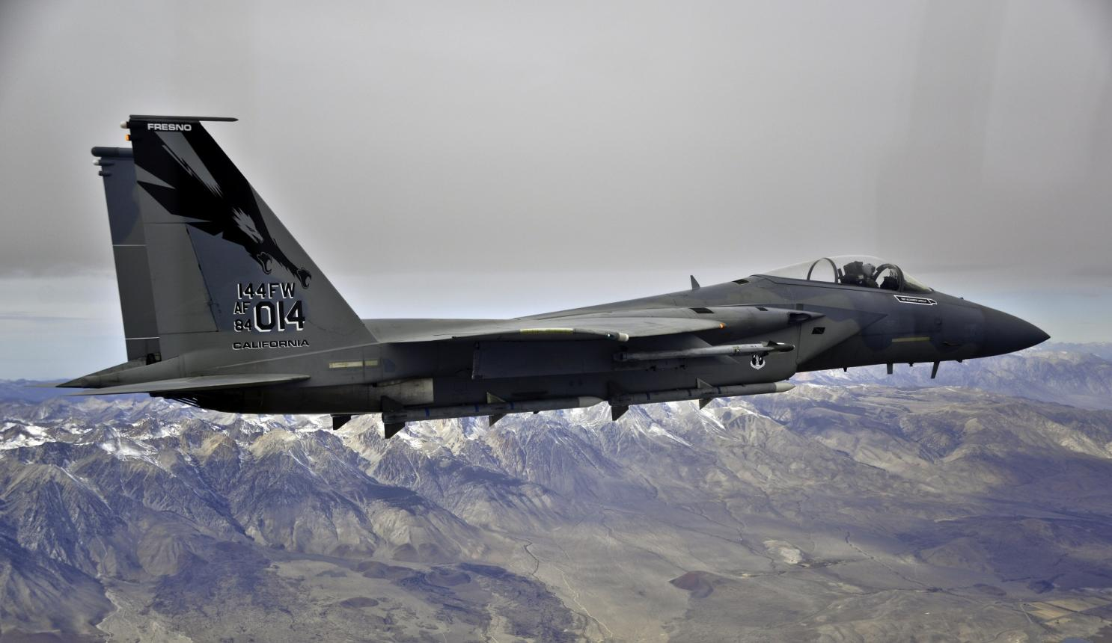
F-15 Eagle

Slide 23
I/O Interface CCA: AS - Repair Robins AFB – 410th SCMS
MD: | F-15
TMS: | N/A
Noun: | Input/Output Interface Circuit Card Assembly
NSN: | 5998-01-330-7909
P/N: | A06G2884-2
Forecasted Buy Price: | $9,462.64
Forecasted Repair Cost: | $7,096.62
AAC: | V
Unserv. Assets Avail: | No
QPA/APPL Rate: | 1 | 100%
AMC/AMSC: | Not Available | Not Available
RMC/RMSC: | 5 | N
Material: | Not Available
Dimensions: | 18.5 IN L X 12.5 IN W X 3 IN H X 5.3 LBS
Criticality Code: | Y
Drawings Releasable: | Yes
Drawing #: | A06G2884
Drawing Cage Code: | 12464
T.O. Releasable: | Yes
T.O. #: | 33A1-5-531-4/33A1-5-531-1
Budget Code: | 8
Next Higher Asmbly: | F-15 METS
Out Year Requirements: BUY
FY24: | 0 | FY25: | 0 | FY26: | 0 | FY27: | 0 | FY28: | 0
Out Year Requirements: REPAIR
FY24: | 2 | FY25: | 2 | FY26: | 1 | FY27: | 1 | FY28: | 1
EDL: | Not Available |  |  |  |  | RDL: | Available
Tinker | 8/10/2023 |  |  |  |  | Robins | 3/24/2023
Hill | 12/8/2022 |  |  |  |  | Virtual | ------
Comments
Provides an individual parallel I/O controller for each PIU that requires program control in the tester.
Deliverables: Source Approval Request (SAR) Package. Please send a request to randy.miller.22@us.af.mil and include your email address and “request a drop off”. A “request for drop off” will be returned, use this to submit your SAR package.
NOTE: Send notification to 429SCMS.SASPO.Workflow@us.af.mil within 45 days of intent to submit SAR package.

Slide 24
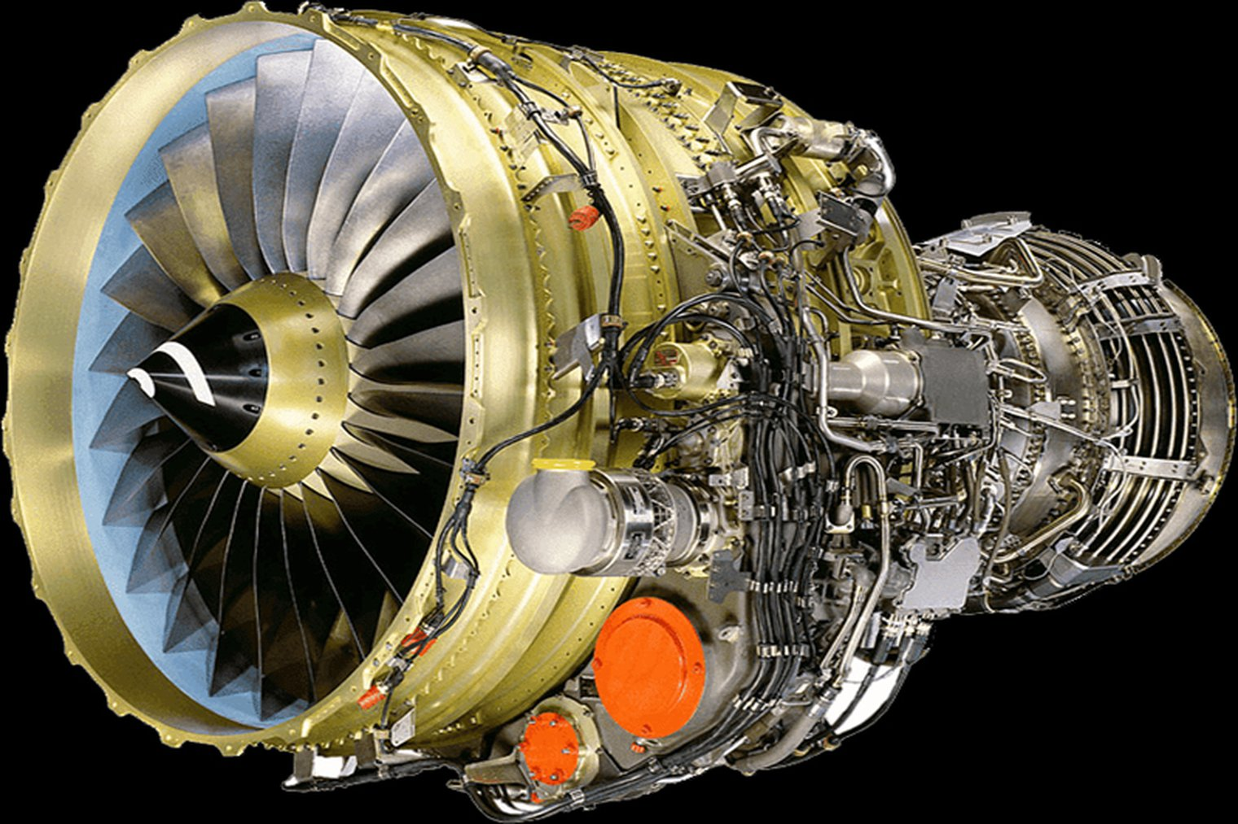
F108 Engine
Supplying Warfighter Dominance

Slide 25
Housing, Gearbox: CUOH-New Buy Tinker AFB – 421st SCMS
MD: | N/A
TMS: | F108-CF-100
Noun: | Housing, Gearbox (AGB)
NSN: | 2840-01-184-8959
P/N: | 301-484-423-0
Forecasted Buy Price: | $123,585.46
Forecasted Repair Cost: | $32,873.73
AAC: | M
Unserv. Assets Avail: | No
QPA/APPL Rate: | 1 | 100%
AMC/AMSC: | 3 | Z
RMC/RMSC: | Not Available | Not Available
Material: | Aluminum Alloy
Dimensions: | 45”L X 15”W X 24”H
Criticality Code: | Y
Drawings Releasable: | No
Drawing #: | Not Available
Drawing Cage Code: | Not Available
T.O. Releasable: | No
T.O. #: | Not Available
Budget Code: | 8
Next Higher Asmbly: | Accessory Drive Gearbox Assy
Out Year Requirements: BUY
FY24: | 4 | FY25: | 4 | FY26: | 4 | FY27: | 4 | FY28: | 4
Out Year Requirements: REPAIR
FY24: | 0 | FY25: | 0 | FY26: | 0 | FY27: | 0 | FY28: | 0
EDL: | Not Available |  |  |  |  | RDL: | Not Available
Tinker | 08/10/2023 |  |  |  |  | Robins | 03/24/2023
Hill | ------ |  |  |  |  | Virtual | ------
Comments
Looking for CFM56 suppliers who have inventory of these Housings
FAA Part 145 approved repair stations may be considered to perform overhaul
Interested vendors should send capabilities statement to 429SCMS.SASPO.Workflow@us.af.mil

Slide 26
Housing, Gearbox: CUOH-New Buy Tinker AFB – 421st SCMS
MD: | N/A
TMS: | F108-CF-100
Noun: | Housing, Gearbox (IGB)
NSN: | 2840-01-187-3185
P/N: | 9976M74G04
Forecasted Buy Price: | $67,309.70
Forecasted Repair Cost: | $24,113.94
AAC: | C
Unserv. Assets Avail: | No
QPA/APPL Rate: | 1 | 100%
AMC/AMSC: | 3 | Z
RMC/RMSC: | 2 | C
Material: | Various Alloys
Dimensions: | 12”L X 12”W X 10”H, 7 LBS
Criticality Code: | Y
Drawings Releasable: | No
Drawing #: | Not Available
Drawing Cage Code: | Not Available
T.O. Releasable: | No
T.O. #: | Not Available
Budget Code: | 8
Next Higher Asmbly: | Inlet Gearbox Assembly
Out Year Requirements: BUY
FY24: | 8 | FY25: | 8 | FY26: | 8 | FY27: | 8 | FY28: | 8
Out Year Requirements: REPAIR
FY24: | 0 | FY25: | 0 | FY26: | 0 | FY27: | 0 | FY28: | 0
EDL: | Not Available |  |  |  |  | RDL: | Not Available
Tinker | 08/10/2023 |  |  |  |  | Robins | 03/24/2023
Hill | ------ |  |  |  |  | Virtual | ------
Comments
Looking for CFM56 suppliers who have inventory of these Housings
FAA Part 145 approved repair stations may be considered to perform overhaul
Interested vendors should send capabilities statement to 429SCMS.SASPO.Workflow@us.af.mil

Slide 27
Housing, Gearbox: CUOH-New Buy Tinker AFB – 421st SCMS
MD: | N/A
TMS: | F108-CF-100
Noun: | Housing, Gearbox, Transfer (TGB)
NSN: | 2840-01-199-1547
P/N: | 301-484-017-0
Forecasted Buy Price: | $190,121.60
Forecasted Repair Cost: | $15,803.49
AAC: | C
Unserv. Assets Avail: | Yes
QPA/APPL Rate: | 1 | 100%
AMC/AMSC: | 3 | Z
RMC/RMSC: | 2 | C
Material: | Aluminum Alloy
Dimensions: | 8”L X 8”W X 10” H, 5LBS
Criticality Code: | F
Drawings Releasable: | No
Drawing #: | Not Available
Drawing Cage Code: | Not Available
T.O. Releasable: | No
T.O. #: | Not Available
Budget Code: | 8
Next Higher Asmbly: | Transfer Gearbox Assembly
Out Year Requirements: BUY
FY24: | 9 | FY25: | 9 | FY26: | 9 | FY27: | 9 | FY28: | 9
Out Year Requirements: REPAIR
FY24: | 0 | FY25: | 0 | FY26: | 0 | FY27: | 0 | FY28: | 0
EDL: | Not Available |  |  |  |  | RDL: | Available
Tinker | 08/10/2023 |  |  |  |  | Robins | 03/24/2023
Hill | ------ |  |  |  |  | Virtual | ------
Comments
Looking for CFM56 suppliers who have inventory of these Housings
FAA Part 145 approved repair stations may be considered to perform overhaul
Interested vendors should send capabilities statement to 429SCMS.SASPO.Workflow@us.af.mil

Slide 28
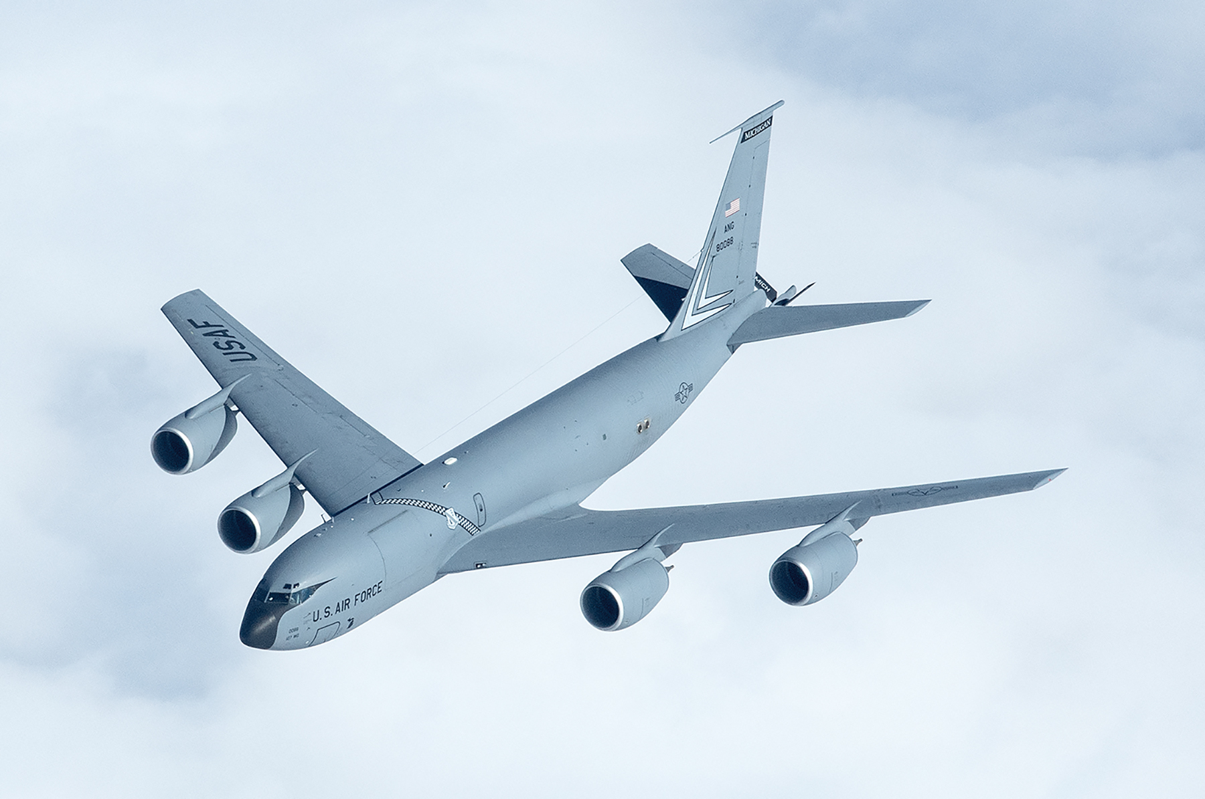
KC-135
Supplying Warfighter Dominance

Slide 29
Servo Valve, Pneumatic: RE – OTA Hill AFB – 419th SCMS
MD: | KC-135
TMS: | N/A
Noun: | Servo Valve, Pneumatic
NSN: | 2990-01-282-5874
P/N: | 26000497
Forecasted Buy Price: | $17,056.86
Forecasted Repair Cost: | N/A
AAC: | Z
Unserv. Assets Avail: | Yes
QPA/APPL Rate: | Not Available | Not Available
AMC/AMSC: | 3 | R
RMC/RMSC: | Not Available | Not Available
Material: | Not Available
Dimensions: | Not Available
Criticality Code: | X
Drawings Releasable: | No
Drawing #: | Not Available
Drawing Cage Code: | Not Available
T.O. Releasable: | Yes
T.O. #: | 6J3-8-19-3
Budget Code: | 9
Next Higher Asmbly: | IGV Actuator – 2920-01-152-6305
Out Year Requirements: BUY
FY24: | 38 | FY25: | 38 | FY26: | 38 | FY27: | 38 | FY28: | 38
Out Year Requirements: REPAIR
FY24: | 0 | FY25: | 0 | FY26: | 0 | FY27: | 0 | FY28: | 0
EDL: | Not Available |  |  |  |  | RDL: | Not Available
Tinker | 8/10/2023 |  |  |  |  | Robins | ------
Hill | ------ |  |  |  |  | Virtual | ------
Comments
Deliverables: Complete Technical Data Package, Prototype, 3D Modeling Data, Testing Procedures.
Interested vendors should submit a White Paper to 429SCMS.SASPO.workflow@us.af.mil
RSVP for Technical Discussion

Slide 30
Servo Valve, Pneumatic: RE – OTA Hill AFB – 419th SCMS
Additional Comments
Current supplier has not been able to deliver due to internal part shortages. Slipped delivery dates several times causing production constraints on the KC 135 APU overhaul. Only “Go/No Go” requirements; no repair or manufacturing instructions; 93% replacement factor. National supply chain shortages cause need to update internal parts.
If you would like to participate in the Technical Discussion on:
September 7, 2023, 11:00AM-12:00PM CDT
provide the following, NLT
August 30, 2023
429SCMS.SASPO.Workflow@us.af.mil
-Company, -Address, -Name(s), -Email(s), -Phone,
-Your questions for Engineering, and
-Statement of Capabilities

Slide 31
Servo Valve: RE – OTA Hill AFB – 419th SCMS
MD: | KC-135
TMS: | N/A
Noun: | Servo Valve
NSN: | 4810-01-213-7948
P/N: | 26000494
Forecasted Buy Price: | $13,892.05
Forecasted Repair Cost: | N/A
AAC: | Z
Unserv. Assets Avail: | Yes
QPA/APPL Rate: | Not Available | Not Available
AMC/AMSC: | 3 | R
RMC/RMSC: | Not Available | Not Available
Material: | Not Available
Dimensions: | Not Available
Criticality Code: | X
Drawings Releasable: | No
Drawing #: | Not Available
Drawing Cage Code: | Not Available
T.O. Releasable: | Yes
T.O. #: | 6J15-3-160-3
Budget Code: | 9
Next Higher Asmbly: | Surge Control Valve
Out Year Requirements: BUY
FY24: | 35 | FY25: | 35 | FY26: | 35 | FY27: | 35 | FY28: | 35
Out Year Requirements: REPAIR
FY24: | 0 | FY25: | 0 | FY26: | 0 | FY27: | 0 | FY28: | 0
EDL: | Not Available |  |  |  |  | RDL: | Not Available
Tinker | 8/10/2023 |  |  |  |  | Robins | ------
Hill | ------ |  |  |  |  | Virtual | ------
Comments
Deliverables: Complete Technical Data Package, Prototype, 3D Modeling Data, Testing Procedures.
Interested vendors should submit a White Paper to 429SCMS.SASPO.workflow@us.af.mil
RSVP for Technical Discussion

Slide 32
Servo Valve: RE – OTA Hill AFB – 419th SCMS
Additional Comments
Current supplier has not been able to deliver due to internal part shortages. Slipped delivery dates several times causing production constraints on the KC 135 APU overhaul. Only “Go/No Go” requirements; no repair or manufacturing instructions; 93% replacement factor. National supply chain shortages cause need to update internal parts.
If you would like to participate in the Technical Discussion on:
September 7, 2023, 11:00AM-12:00PM CDT
provide the following, NLT
August 30, 2023
429SCMS.SASPO.Workflow@us.af.mil
-Company, -Address, -Name(s), -Email(s), -Phone,
-Your questions for Engineering, and
-Statement of Capabilities

Slide 33
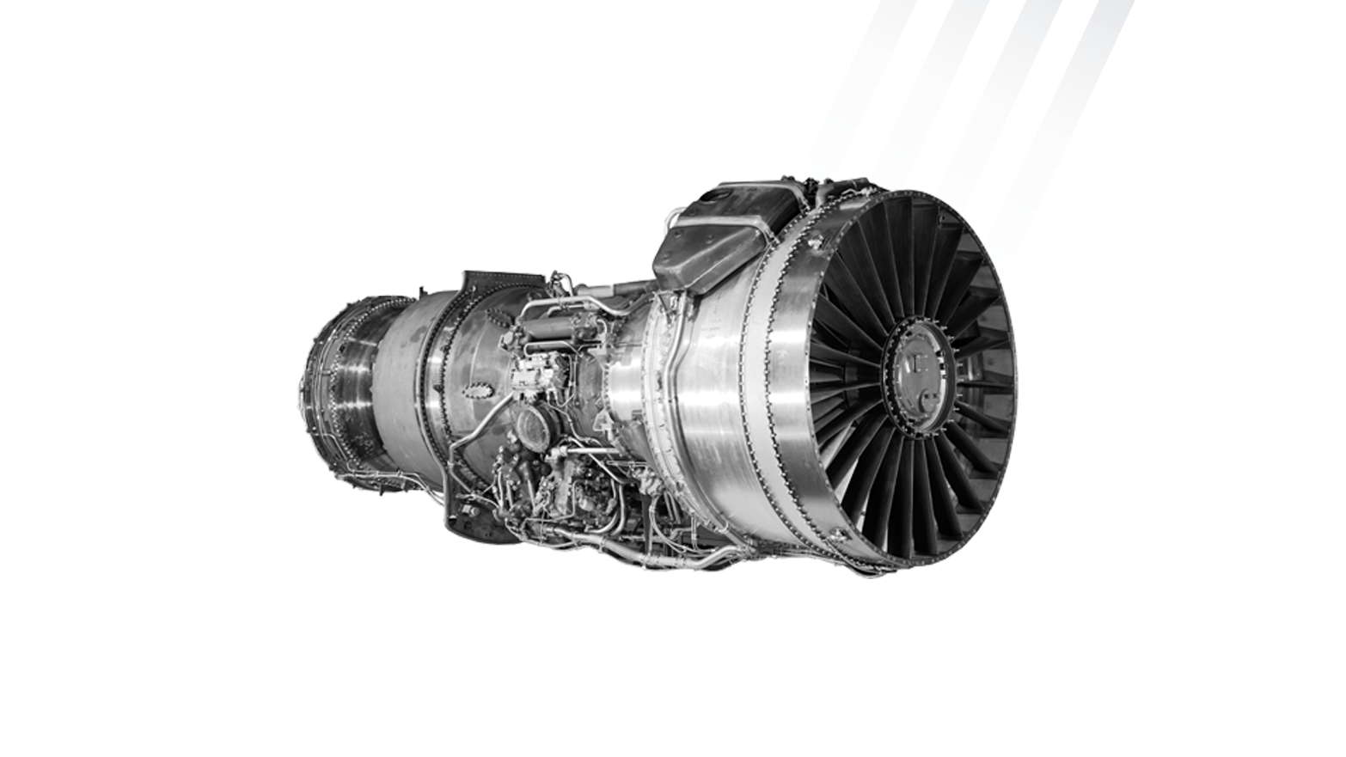
TF33 Engine
Supplying Warfighter Dominance

Slide 34
Clamp, Comb Chamber: AS - Repair Tinker AFB – 421ST SCMS
MD: | N/A
TMS: | TF-33
Noun: | Clamp, Combustion Chamber
NSN: | 2840-00-169-0191
P/N: | 622382
Forecasted Buy Price: | $1016.49
Forecasted Repair Cost: | $300.19
AAC: | C
Unserv. Assets Avail: | Yes
QPA/APPL Rate: | 8 | 100
AMC/AMSC: | 1 | C
RMC/RMSC: | 1 | C
Material: | Nickel Alloy
Dimensions: | 10”Dia X 2.6” H 5lbs
Criticality Code: | Y
Drawings Releasable: | Yes
Drawing #: | 622382
Drawing Cage Code: | 77445
T.O. Releasable: | Yes
T.O. #: | 2J-TF33-53-7
Budget Code: | 8
Next Higher Asmbly:
Out Year Requirements: BUY
FY24: | 0 | FY25: | 0 | FY26: | 0 | FY27: | 0 | FY28: | 0
Out Year Requirements: REPAIR
FY24: | 150 | FY25: | 280 | FY26: | 280 | FY27: | 280 | FY28: | 280
EDL: | Available |  |  |  |  | RDL: | Available
Tinker | 8/10/2023 |  |  |  |  | Robins | ------
Hill | ------ |  |  |  |  | Virtual | ------
Comments
Deliverables: Source Approval Request (SAR) Package.
Interested vendors should submit a Source Approval Request (SAR) to 429SCMS.SASPO.Workflow@us.af.mil
NOTE: Send notification to 429SCMS.SASPO.Workflow@us.af.mil within 45 days of intent to submit SAR package.

Slide 35
Oil Tank Cushion: AS – New Buy Tinker AFB – LCMC
MD: | N/A
TMS: | TF33-PW-103
Noun: | Oil Tank Cushion
NSN: | 2840-00-787-7803
P/N: | 415750
Forecasted Buy Price: | $963.78
Forecasted Repair Cost: | N/A
AAC: | Z
Unserv. Assets Avail: | No
QPA/APPL Rate: | 2 | 100%
AMC/AMSC: | 1 | C
RMC/RMSC: | Not Available | Not Available
Material: | Not Available
Dimensions: | Not Available
Criticality Code: | Y
Drawings Releasable: | Yes
Drawing #: | 415750
Drawing Cage Code: | 77445
T.O. Releasable: | Yes
T.O. #: | 2J-TF33-4
Budget Code: | 9
Next Higher Asmbly: | Not Available
Out Year Requirements: BUY
FY24: | 76 | FY25: | 84 | FY26: | 76 | FY27: | 21 | FY28: | 107
Out Year Requirements: REPAIR
FY24: | 0 | FY25: | 0 | FY26: | 0 | FY27: | 0 | FY28: | 0
EDL: | Available |  |  |  |  | RDL: | Not Available
Tinker | 08/10/2023 |  |  |  |  | Robins | 03/24/2023
Hill | ------ |  |  |  |  | Virtual | ------
Comments
Deliverables: Source Approval Request (SAR) Package.
Interested vendors should submit a Source Approval Request (SAR) to dlaavnsmallbus@dla.mil
NOTE: Send notification to 429SCMS.SASPO.Workflow@us.af.mil within 45 days of intent to submit SAR package.

Slide 36
Counterbalance Weight: AS – New Buy Tinker AFB - LCMC
MD: | N/A
TMS: | TF33-PW-100A, TF33-PW-103, TF33-PW-102C
Noun: | Counterbalance Weight
NSN: | 3040-00-442-3631
P/N: | 502281CL1
Forecasted Buy Price: | $29.50
Forecasted Repair Cost: | N/A
AAC: | Z
Unserv. Assets Avail: | No
QPA/APPL Rate: | 0 | 0
AMC/AMSC: | 3 | C
RMC/RMSC: | Not Available | Not Available
Material: | AMS 5613 Stainless Steel
Dimensions: | 0.478-0.488 ID X 0.000-0.086 ID
Criticality Code: | X
Drawings Releasable: | Yes
Drawing #: | 502281
Drawing Cage Code: | 77445
T.O. Releasable: | Yes
T.O. #: | 2J-TF33-4/-34/-44
Budget Code: | 9
Next Higher Asmbly: | HS Comp
Out Year Requirements: BUY
FY24: | 0 | FY25: | 44 | FY26: | 0 | FY27: | 0 | FY28: | 0
Out Year Requirements: REPAIR
FY24: | 0 | FY25: | 0 | FY26: | 0 | FY27: | 0 | FY28: | 0
EDL: | Not Available |  |  |  |  | RDL: | Not Available
Tinker | 8/10/2023 |  |  |  |  | Robins | 3/24/2023
Hill | ------ |  |  |  |  | Virtual | ------
Comments
Deliverables: Source Approval Request (SAR) Package.
Interested vendors should submit a Source Approval Request (SAR) to dlaavnsmallbus@dla.mil.
NOTE: Send notification to 429SCMS.SASPO.Workflow@us.af.mil within 45 days of intent to submit SAR package

Slide 37
Counterbalance Weight: AS – New Buy Tinker AFB - LCMC
MD: | N/A
TMS: | TF33-P-103, TF33-PW-100A
Noun: | Counterbalance Weight
NSN: | 3040-00-983-1153
P/N: | 461035CL6
Forecasted Buy Price: | $7.22
Forecasted Repair Cost: | N/A
AAC: | D
Unserv. Assets Avail: | No
QPA/APPL Rate: | 1 | 100%
AMC/AMSC: | 1 | C
RMC/RMSC: | Not Available | Not Available
Material: | AMS 5613 SST
Dimensions: | 0.375 IN DIA – 0.3125-24 UNF -28
Criticality Code: | Y
Drawings Releasable: | Yes
Drawing #: | 461035
Drawing Cage Code: | 77445
T.O. Releasable: | Yes
T.O. #: | 2J-TF33-4/-44
Budget Code: | 9
Next Higher Asmbly: | L S Turb
Out Year Requirements: BUY
FY24: | 241 | FY25: | 241 | FY26: | 483 | FY27: | 242 | FY28: | 0
Out Year Requirements: REPAIR
FY24: | 0 | FY25: | 0 | FY26: | 0 | FY27: | 0 | FY28: | 0
EDL: | Available |  |  |  |  | RDL: | Not Available
Tinker | 8/10/2023 |  |  |  |  | Robins | 3/24/2023
Hill | ------ |  |  |  |  | Virtual | ------
Comments
Deliverables: Source Approval Request (SAR) Package.
Interested vendors should submit a Source Approval Request (SAR) to dlaavnsmallbus@dla.mil
NOTE: Send notification to 429SCMS.SASPO.Workflow@us.af.mil within 45 days of intent to submit SAR package.

Slide 38
Bearing Sleeve: AS – New Buy Tinker AFB - LCMC
MD: | N/A
TMS: | TF33-PW-100A, TF33-PW-102C. TF33-PW-103
Noun: | Bearing Sleeve
NSN: | 3120-00-226-4671
P/N: | 480162
Forecasted Buy Price: | $146.82
Forecasted Repair Cost: | N/A
AAC: | D
Unserv. Assets Avail: | No
QPA/APPL Rate: | 0 | 0
AMC/AMSC: | 1 | C
RMC/RMSC: | Not Available | Not Available
Material: | Caron Graphite Overall
Dimensions: | Length 0.3070 IN MIN and 0.385 IN MAX, Body Outside DIA 0.3850 IN MIN and 0.3860 IN MAX
Criticality Code: | X
Drawings Releasable: | Yes
Drawing #: | 480162
Drawing Cage Code: | 77445
T.O. Releasable: | Yes
T.O. #: | 2J-Tf33-4/-34/-44
Budget Code: | 9
Next Higher Asmbly: | Air Accy
Out Year Requirements: BUY
FY24: | 40 | FY25: | 41 | FY26: | 41 | FY27: | 0 | FY28: | 0
Out Year Requirements: REPAIR
FY24: | 0 | FY25: | 0 | FY26: | 0 | FY27: | 0 | FY28: | 0
EDL: | Not Available |  |  |  |  | RDL: | Not Available
Tinker | 8/10/2023 |  |  |  |  | Robins | 3/24/2023
Hill | ------ |  |  |  |  | Virtual | ------
Comments
Deliverables: Source Approval Request (SAR) Package.
Interested vendors should submit a Source Approval Request (SAR) to dlaavnsmallbus@dla.mil.
NOTE: Send notification to 429SCMS.SASPO.Workflow@us.af.mil within 45 days of intent to submit SAR package.

Slide 39
Compressor Baffle: AS – New Buy Tinker AFB – LCMC
MD: | N/A
TMS: | TF33-PW-103
Noun: | Compressor Baffle
NSN: | 4820-00-348-8796
P/N: | 286958
Forecasted Buy Price: | $539.18
Forecasted Repair Cost: | N/A
AAC: | Z
Unserv. Assets Avail: | No
QPA/APPL Rate: | 1 | 100%
AMC/AMSC: | 2 | C
RMC/RMSC: | Not Available | Not Available
Material: | Steel
Dimensions: | Not Available
Criticality Code: | X
Drawings Releasable: | Yes
Drawing #: | 286958
Drawing Cage Code: | 77445
T.O. Releasable: | Yes
T.O. #: | 9P5-17-1-113
Budget Code: | 9
Next Higher Asmbly: | Compressor Bleed Valve
Out Year Requirements: BUY
FY24: | 50 | FY25: | 35 | FY26: | 52 | FY27: | 55 | FY28: | 25
Out Year Requirements: REPAIR
FY24: | 0 | FY25: | 0 | FY26: | 0 | FY27: | 0 | FY28: | 0
EDL: | Available |  |  |  |  | RDL: | Not Available
Tinker | 08/10/2023 |  |  |  |  | Robins | 03/24/2023
Hill | ------ |  |  |  |  | Virtual | ------
Comments
Deliverables: Source Approval Request (SAR) Package.
Interested vendors should submit a Source Approval Request (SAR) to dlaavnsmallbus@dla.mil
NOTE: Send notification to 429SCMS.SASPO.Workflow@us.af.mil within 45 days of intent to submit SAR package.

Slide 40
Seat Valve: AS – New Buy Tinker AFB – LCMC
MD: | N/A
TMS: | TF33-PW-100A, TF33-PW-102C, TF33-PW-103
Noun: | Seat-Valve, Oil Filter Check
NSN: | 4820-01-202-6339
P/N: | 755936
Forecasted Buy Price: | $497.70
Forecasted Repair Cost: | N/A
AAC: | Z
Unserv. Assets Avail: | No
QPA/APPL Rate: | 1 | 100%
AMC/AMSC: | 1 | C
RMC/RMSC: | Not Available | Not Available
Material: | Corrosion Resistant Steel
Dimensions: | 2.95 In X 2.496 In
Criticality Code: | X
Drawings Releasable: | Yes
Drawing #: | 755936
Drawing Cage Code: | 77445
T.O. Releasable: | Yes
T.O. #: | 2J-TF33-4,-34,-44
Budget Code: | 9
Next Higher Asmbly: | Oil Filter Assy
Out Year Requirements: BUY
FY24: | 11 | FY25: | 0 | FY26: | 0 | FY27: | 0 | FY28: | 0
Out Year Requirements: REPAIR
FY24: | 0 | FY25: | 0 | FY26: | 0 | FY27: | 0 | FY28: | 0
EDL: | Not Available |  |  |  |  | RDL: | Not Available
Tinker | 08/10/2023 |  |  |  |  | Robins | ------
Hill | ------ |  |  |  |  | Virtual | ------
Comments
Deliverables: Source Approval Request (SAR) Package.
Interested vendors should submit a Source Approval Request (SAR) to dlaavnsmallbus@dla.mil
NOTE: Send notification to 429SCMS.SASPO.Workflow@us.af.mil within 45 days of intent to submit SAR package.

Slide 41
Body Bolt: AS – New Buy Tinker AFB – LCMC
MD: | N/A
TMS: | TF33-PW-100A, TF33-PW-102C, TF33-PW-103
Noun: | Externally Relieved Body Bolt
NSN: | 5306-00-807-1442
P/N: | 387377
Forecasted Buy Price: | $ 11.86
Forecasted Repair Cost: | N/A
AAC: | Z
Unserv. Assets Avail: | No
QPA/APPL Rate: | 10 | 100%
AMC/AMSC: | 1 | C
RMC/RMSC: | Not Available | Not Available
Material: | AMS 5616 SST
Dimensions: | 0.3125-24 X 3.100 Long
Criticality Code: | X
Drawings Releasable: | Yes
Drawing #: | 387377
Drawing Cage Code: | 77445
T.O. Releasable: | Yes
T.O. #: | 2J-TF33-44
Budget Code: | 9
Next Higher Asmbly: | Exhaust Case Assembly
Out Year Requirements: BUY
FY24: | 484 | FY25: | 483 | FY26: | 484 | FY27: | 483 | FY28: | 514
Out Year Requirements: REPAIR
FY24: | 0 | FY25: | 0 | FY26: | 0 | FY27: | 0 | FY28: | 0
EDL: | Available |  |  |  |  | RDL: | Not Available
Tinker | 08/10/2023 |  |  |  |  | Robins | 03/24/2023
Hill | ------ |  |  |  |  | Virtual | ------
Comments
Deliverables: Source Approval Request (SAR) Package.
Interested vendors should submit a Source Approval Request (SAR) to dlaavnsmallbus@dla.mil
NOTE: Send notification to 429SCMS.SASPO.Workflow@us.af.mil within 45 days of intent to submit SAR package.

Slide 42
Machine Bolt: AS – New Buy Tinker AFB – LCMC
MD: | N/A
TMS: | TF33-PW-100A, TF33-PW-102C, TF33-PW-103
Noun: | Machine Bolt
NSN: | 5306-01-354-0200
P/N: | MS9148-12
Forecasted Buy Price: | $4.13
Forecasted Repair Cost: | N/A
AAC: | Z
Unserv. Assets Avail: | No
QPA/APPL Rate: | 0 | 0
AMC/AMSC: | 1 | G
RMC/RMSC: | Not Available | Not Available
Material: | Steel Comp 8740 Overall
Dimensions: | Length – 0.990 IN MIN and 1.010 IN MAX DIA – 0.312 IN
Criticality Code: | X
Drawings Releasable: | No
Drawing #: | Not Available
Drawing Cage Code: | 96906
T.O. Releasable: | Yes
T.O. #: | 2J-TF33-4/-34/-44
Budget Code: | 9
Next Higher Asmbly: | Gas Turbine Engine Compresser
Out Year Requirements: BUY
FY24: | 72 | FY25: | 72 | FY26: | 72 | FY27: | 72 | FY28: | 78
Out Year Requirements: REPAIR
FY24: | 0 | FY25: | 0 | FY26: | 0 | FY27: | 0 | FY28: | 0
EDL: | Not Available |  |  |  |  | RDL: | Not Available
Tinker | 8/10/2023 |  |  |  |  | Robins | 3/24/2023
Hill | ------ |  |  |  |  | Virtual | ------
Comments
Interested vendors should query DLA Internet Bid Board System (DIBBS) for future opportunities

Slide 43
Shouldered Washer: AS – New Buy Tinker AFB - LCMC
MD: | N/A
TMS: | TF33-P-102C, TF33-P-103
Noun: | Shouldered Washer
NSN: | 5310-00-164-1100
P/N: | 579856
Forecasted Buy Price: | $20.55
Forecasted Repair Cost: | NA
AAC: | Z
Unserv. Assets Avail: | No
QPA/APPL Rate: | 2 | 100%
AMC/AMSC: | 1 | C
RMC/RMSC: | Not Available | Not Available
Material: | AMS 6322 STL
Dimensions: | 0.276 IN MIN and 0.286 IN MAX Hole DIA; 0.61 IN MIN and 0.63 IN MAX OD
Criticality Code: | X
Drawings Releasable: | Yes
Drawing #: | 579856
Drawing Cage Code: | 77445
T.O. Releasable: | Yes
T.O. #: | 2J-TF33-4/-34
Budget Code: | 9
Next Higher Asmbly: | Gearbox
Out Year Requirements: BUY
FY24: | 99 | FY25: | 98 | FY26: | 99 | FY27: | 24 | FY28: | 148
Out Year Requirements: REPAIR
FY24: | 0 | FY25: | 0 | FY26: | 0 | FY27: | 0 | FY28: | 0
EDL: | Not Available |  |  |  |  | RDL: | Not Available
Tinker | 8/10/2023 |  |  |  |  | Robins | 3/24/2023
Hill | ------ |  |  |  |  | Virtual | ------
Comments
Deliverables: Source Approval Request (SAR) Package.
Interested vendors should submit a Source Approval Request (SAR) to dlaavnsmallbus@dla.mil
NOTE: Send notification to 429SCMS.SASPO.Workflow@us.af.mil within 45 days of intent to submit SAR package.

Slide 44
Key Washer: AS – New Buy Tinker AFB – LCMC
MD: | N/A
TMS: | TF33-PW-100A, TF33-PW-102C, TF33-PW-103
Noun: | Key Washer
NSN: | 5310-00-336-2841
P/N: | 227340
Forecasted Buy Price: | $ 2.70
Forecasted Repair Cost: | N/A
AAC: | D
Unserv. Assets Avail: | No
QPA/APPL Rate: | 32 | 100%
AMC/AMSC: | 1 | C
RMC/RMSC: | Not Available | Not Available
Material: | Steel Comp 410
Dimensions: | Not Available
Criticality Code: | Y
Drawings Releasable: | No
Drawing #: | Not Available
Drawing Cage Code: | Not Available
T.O. Releasable: | Yes
T.O. #: | 2J-TF33-4, -34, -44
Budget Code: | 9
Next Higher Asmbly: | Diffuser Case Assembly
Out Year Requirements: BUY
FY24: | 5420 | FY25: | 2724 | FY26: | 5422 | FY27: | 2797 | FY28: | 5420
Out Year Requirements: REPAIR
FY24: | 0 | FY25: | 0 | FY26: | 0 | FY27: | 0 | FY28: | 0
EDL: | Available |  |  |  |  | RDL: | Not Available
Tinker | 08/10/2023 |  |  |  |  | Robins | 03/24/2023
Hill | ------ |  |  |  |  | Virtual | ------
Comments
Deliverables: Source Approval Request (SAR) Package.
Interested vendors should submit a Source Approval Request (SAR) to dlaavnsmallbus@dla.mil
NOTE: Send notification to 429SCMS.SASPO.Workflow@us.af.mil within 45 days of intent to submit SAR package.

Slide 45
Key Washer: AS – New Buy Tinker AFB - LCMC
MD: | N/A
TMS: | TF33-PW-100A, TF33-PW-102C, TF33-PW-103
Noun: | Key Washer
NSN: | 5310-00-766-4243
P/N: | 387330
Forecasted Buy Price: | $1.67
Forecasted Repair Cost: | N/A
AAC: | Z
Unserv. Assets Avail: | No
QPA/APPL Rate: | 0 | 0
AMC/AMSC: | 1 | G
RMC/RMSC: | Not Available | Not Available
Material: | Steel Comp 304L
Dimensions: | Hole DIA 0.590 IN MIN – 0.600 IN MAX; OD 0.900 IN MIN – 0.920 IN MAX
Criticality Code: | X
Drawings Releasable: | Yes
Drawing #: | 387330
Drawing Cage Code: | 77445
T.O. Releasable: | Yes
T.O. #: | 2J-TF33-4/-34/-44
Budget Code: | 9
Next Higher Asmbly: | Turbine Rotor Assembly
Out Year Requirements: BUY
FY24: | 400 | FY25: | 400 | FY26: | 800 | FY27: | 400 | FY28: | 800
Out Year Requirements: REPAIR
FY24: | 0 | FY25: | 0 | FY26: | 0 | FY27: | 0 | FY28: | 0
EDL: | Not Available |  |  |  |  | RDL: | Not Available
Tinker | 8/10/2023 |  |  |  |  | Robins | 3/24/2023
Hill | ------ |  |  |  |  | Virtual | ------
Comments
Interested vendors should query DLA Internet Bid Board System (DIBBS) for future opportunities

Slide 46
Retaining Ring: AS – New Buy Tinker AFB – LCMC
MD: | N/A
TMS: | TF33-P-102C, TF33-P-103
Noun: | Retaining Ring
NSN: | 5325-00-802-6799
P/N: | 386443
Forecasted Buy Price: | $7.48
Forecasted Repair Cost: | N/A
AAC: | D
Unserv. Assets Avail: | Yes
QPA/APPL Rate: | 1 | 100%
AMC/AMSC: | 1 | C
RMC/RMSC: | Not Available | Not Available
Material: | AMS 5120 Steel
Dimensions: | 2.980" OD; 0.071" Minor Thickness; 0.093" Major Thickness
Criticality Code: | F
Drawings Releasable: | Yes
Drawing #: | 386443
Drawing Cage Code: | 77445
T.O. Releasable: | Yes
T.O. #: | 2J-TF33-4/-34
Budget Code: | 9
Next Higher Asmbly: | Gearbox Assembly
Out Year Requirements: BUY
FY24: | 22 | FY25: | 44 | FY26: | 22 | FY27: | 0 | FY28: | 0
Out Year Requirements: REPAIR
FY24: | 0 | FY25: | 0 | FY26: | 0 | FY27: | 0 | FY28: | 0
EDL: | Available |  |  |  |  | RDL: | Not Available
Tinker | 08/10/2023 |  |  |  |  | Robins | 03/24/2023
Hill | ------ |  |  |  |  | Virtual | ------
Comments
Deliverables: Source Approval Request (SAR) Package.
Interested vendors should submit a Source Approval Request (SAR) to dlaavnsmallbus@dla.mil
NOTE: Send notification to 429SCMS.SASPO.Workflow@us.af.mil within 45 days of intent to submit SAR package.

Slide 47
Gasket: AS – New Buy Tinker AFB – LCMC
MD: | N/A
TMS: | TF33-PW-100, -103
Noun: | Gasket
NSN: | 5330-00-796-9180
P/N: | 395346
Forecasted Buy Price: | $10.87
Forecasted Repair Cost: | N/A
AAC: | D
Unserv. Assets Avail: | No
QPA/APPL Rate: | 1 | 100%
AMC/AMSC: | 1 | C
RMC/RMSC: | Not Available | Not Available
Material: | Aluminum Alloy 1100
Dimensions: | 2.290” OD x 1.930” ID x 0.061” thick
Criticality Code: | X
Drawings Releasable: | Yes
Drawing #: | 395346
Drawing Cage Code: | 77445
T.O. Releasable: | Yes
T.O. #: | 2J-TF33-4, -44
Budget Code: | 9
Next Higher Asmbly: | Air/Oil Cooler Assy
Out Year Requirements: BUY
FY24: | 335 | FY25: | 268 | FY26: | 268 | FY27: | 0 | FY28: | 0
Out Year Requirements: REPAIR
FY24: | 0 | FY25: | 0 | FY26: | 0 | FY27: | 0 | FY28: | 0
EDL: | Available |  |  |  |  | RDL: | Not Available
Tinker | 08/10/2023 |  |  |  |  | Robins | ------
Hill | ------ |  |  |  |  | Virtual | ------
Comments
Deliverables: Source Approval Request (SAR) Package.
Interested vendors should submit a Source Approval Request (SAR) to dlaavnsmallbus@dla.mil
NOTE: Send notification to 429SCMS.SASPO.Workflow@us.af.mil within 45 days of intent to submit SAR package.

Slide 48
Metal Seal Ring: AS – New Buy Tinker AFB – LCMC
MD: | N/A
TMS: | TF33-PW-100A, TF33-PW 102C, TF33-PW-103
Noun: | Metal Seal Ring
NSN: | 5330-00-992-1516
P/N: | 481314
Forecasted Buy Price: | $255.07
Forecasted Repair Cost: | N/A
AAC: | D
Unserv. Assets Avail: | No
QPA/APPL Rate: | 1 | 100%
AMC/AMSC: | 1 | C
RMC/RMSC: | Not Available | Not Available
Material: | Steel
Dimensions: | 2.125" Min/2.127" Max OD; 0.135" Min/0.145" Max Rad Wall Thickness; 0.07" Min/0.072" Max W
Criticality Code: | X
Drawings Releasable: | Yes
Drawing #: | 481314
Drawing Cage Code: | 77445
T.O. Releasable: | Yes
T.O. #: | 2J-TF33-4, -34, -44
Budget Code: | 9
Next Higher Asmbly: | Anti Icing Valve Assembly
Out Year Requirements: BUY
FY24: | 94 | FY25: | 70 | FY26: | 93 | FY27: | 41 | FY28: | 86
Out Year Requirements: REPAIR
FY24: | 0 | FY25: | 0 | FY26: | 0 | FY27: | 0 | FY28: | 0
EDL: | Not Available |  |  |  |  | RDL: | Not Available
Tinker | 08/10/2023 |  |  |  |  | Robins | 03/24/2023
Hill | ------ |  |  |  |  | Virtual | ------
Comments
Deliverables: Source Approval Request (SAR) Package.
Interested vendors should submit a Source Approval Request (SAR) to dlaavnsmallbus@dla.mil
NOTE: Send notification to 429SCMS.SASPO.Workflow@us.af.mil within 45 days of intent to submit SAR package.

Slide 49
O-Ring: AS – New Buy Tinker AFB - LCMC
MD: | N/A
TMS: | TF33-PW-100A
Noun: | O-Ring
NSN: | 5331-00-425-9124
P/N: | AS3208-08
Forecasted Buy Price: | $0.30
Forecasted Repair Cost: | N/A
AAC: | Z
Unserv. Assets Avail: | No
QPA/APPL Rate: | 5 | 100%
AMC/AMSC: | 1 | G
RMC/RMSC: | Not Available | Not Available
Material: | AMS 7276 Fluorocarbon Rubber
Dimensions: | 0.664 IN ID X 0.087 IN DIA Round
Criticality Code: | X
Drawings Releasable: | Yes
Drawing #: | AS3208
Drawing Cage Code: | 77445
T.O. Releasable: | Yes
T.O. #: | 2J-TF33-44
Budget Code: | 9
Next Higher Asmbly: | Main Gearbox
Out Year Requirements: BUY
FY24: | 2778 | FY25: | 0 | FY26: | 0 | FY27: | 0 | FY28: | 0
Out Year Requirements: REPAIR
FY24: | 0 | FY25: | 0 | FY26: | 0 | FY27: | 0 | FY28: | 0
EDL: | Not Available |  |  |  |  | RDL: | Not Available
Tinker | 8/10/2023 |  |  |  |  | Robins | 3/24/2023
Hill | ------ |  |  |  |  | Virtual | ------
Comments
Interested vendors should query DLA Internet Bid Board System (DIBBS) for future opportunities

Slide 50
O-Ring: AS – New Buy Tinker AFB - LCMC
MD: | N/A
TMS: | TF33-PW-100A, TF33-PW-102C, TF33-PW-103
Noun: | O-Ring
NSN: | 5331-00-618-3447
P/N: | AS3578-008
Forecasted Buy Price: | $0.17
Forecasted Repair Cost: | N/A
AAC: | D
Unserv. Assets Avail: | No
QPA/APPL Rate: | 1 | 100%
AMC/AMSC: | 2 | G
RMC/RMSC: | Not Available | Not Available
Material: | Rubber Butadiene-Acrylonitrile Class NBR
Dimensions: | OD-0.305 IN MIN / 0.327 IN MAX; CTR Hole DIA 0.171 IN MIN / 0.181 IN MAX; Cross Sect. Hgt 0.067 IN MIN / 0.073 IN MAX
Criticality Code: | X
Drawings Releasable: | No
Drawing #: | Not Available
Drawing Cage Code: | Not Available
T.O. Releasable: | Yes
T.O. #: | 2J-TF33-4/-34/-44
Budget Code: | 9
Next Higher Asmbly: | Fuel Filter Assembly
Out Year Requirements: BUY
FY24: | 0 | FY25: | 0 | FY26: | 0 | FY27: | 0 | FY28: | 0
Out Year Requirements: REPAIR
FY24: | 0 | FY25: | 0 | FY26: | 0 | FY27: | 0 | FY28: | 0
EDL: | Not Available |  |  |  |  | RDL: | Not Available
Tinker | 8/10/2023 |  |  |  |  | Robins | 3/24/2023
Hill | ------ |  |  |  |  | Virtual | ------
Comments
Interested vendors should query DLA Internet Bid Board System (DIBBS) for future opportunities

Slide 51
O-Ring: AS – New Buy Tinker AFB - LCMC
MD: | N/A
TMS: | TF33-P-103, TF33-PW-100A
Noun: | O-Ring
NSN: | 5331-01-010-2929
P/N: | ST1050-158
Forecasted Buy Price: | $1.33
Forecasted Repair Cost: | N/A
AAC: | Z
Unserv. Assets Avail: | No
QPA/APPL Rate: | 1 | 100%
AMC/AMSC: | 1 | G
RMC/RMSC: | Not Available | Not Available
Material: | AMS 7276 Fluorocarbon Rubber
Dimensions: | Center Hole DIA 4.722 IN MIN X 4.752 IN MAX; Cross Sect. Height 0.100 IN MIN X 0.106 IN MAX
Criticality Code: | X
Drawings Releasable: | Yes
Drawing #: | ST1050
Drawing Cage Code: | 77445
T.O. Releasable: | Yes
T.O. #: | 2J-TF33-4/-44
Budget Code: | 9
Next Higher Asmbly: | Gearbox
Out Year Requirements: BUY
FY24: | 603 | FY25: | 0 | FY26: | 0 | FY27: | 0 | FY28: | 0
Out Year Requirements: REPAIR
FY24: | 0 | FY25: | 0 | FY26: | 0 | FY27: | 0 | FY28: | 0
EDL: | Not Available |  |  |  |  | RDL: | Not Available
Tinker | 8/10/2023 |  |  |  |  | Robins | 3/24/2023
Hill | ------ |  |  |  |  | Virtual | ------
Comments
Interested vendors should query DLA Internet Bid Board System (DIBBS) for future opportunities

Slide 52
Nut Locking Plate: AS – New Buy Tinker AFB - LCMC
MD: | N/A
TMS: | TF33-P-103, TF33-PW-100A
Noun: | Nut Locking Plate
NSN: | 5340-00-510-1243
P/N: | 302901
Forecasted Buy Price: | $2.92
Forecasted Repair Cost: | N/A
AAC: | Z
Unserv. Assets Avail: | No
QPA/APPL Rate: | 3 | 100%
AMC/AMSC: | 1 | G
RMC/RMSC: | Not Available | Not Available
Material: | AMS 5504 Stainless Steel
Dimensions: | 0.281 IN ID X 0.845 IN Long
Criticality Code: | X
Drawings Releasable: | Yes
Drawing #: | 302901
Drawing Cage Code: | 77445
T.O. Releasable: | Yes
T.O. #: | 2J-TF33-4/-44
Budget Code: | 9
Next Higher Asmbly: | Turbine Engine Rear Bearing Support
Out Year Requirements: BUY
FY24: | 386 | FY25: | 386 | FY26: | 386 | FY27: | 386 | FY28: | 0
Out Year Requirements: REPAIR
FY24: | 0 | FY25: | 0 | FY26: | 0 | FY27: | 0 | FY28: | 0
EDL: | Not Available |  |  |  |  | RDL: | Not Available
Tinker | 8/10/2023 |  |  |  |  | Robins | 3/24/2023
Hill | ------ |  |  |  |  | Virtual | ------
Comments
Interested vendors should query DLA Internet Bid Board System (DIBBS) for future opportunities

Slide 53
Helical Compressor Spring: AS – New Buy Tinker AFB - LCMC
MD: | N/A
TMS: | TF33-P-103, TF33-PW100A
Noun: | Helical Compressor Spring
NSN: | 5360-00-663-1118
P/N: | 288569
Forecasted Buy Price: | $67.54
Forecasted Repair Cost: | N/A
AAC: | V
Unserv. Assets Avail: | No
QPA/APPL Rate: | 1 | 100%
AMC/AMSC: | 1 | C
RMC/RMSC: | Not Available | Not Available
Material: | Stainless Steel AMS 5688
Dimensions: | 1.662 IN OD X 0.172 IN DIA Wire
Criticality Code: | X
Drawings Releasable: | Yes
Drawing #: | 288569
Drawing Cage Code: | 77445
T.O. Releasable: | Yes
T.O. #: | 2J-TF33-4/-44
Budget Code: | 9
Next Higher Asmbly: | Fuel Pressurizing and Dump Valve
Out Year Requirements: BUY
FY24: | 65 | FY25: | 66 | FY26: | 65 | FY27: | 143 | FY28: | 0
Out Year Requirements: REPAIR
FY24: | 0 | FY25: | 0 | FY26: | 0 | FY27: | 0 | FY28: | 0
EDL: | Available |  |  |  |  | RDL: | Not Available
Tinker | 8/10/2023 |  |  |  |  | Robins | 3/24/2023
Hill | ------ |  |  |  |  | Virtual | ------
Comments
Deliverables: Source Approval Request (SAR) Package.
Interested vendors should submit a Source Approval Request (SAR) to dlaavnsmallbus@dla.mil
NOTE: Send notification to 429SCMS.SASPO.Workflow@us.af.mil within 45 days of intent to submit SAR package.

Slide 54
Compressor Helical Spring: AS – New Buy Tinker AFB – LCMC
MD: | N/A
TMS: | TF33-P-102C
Noun: | Compressor Helical Spring
NSN: | 5360-00-663-1366
P/N: | 480729
Forecasted Buy Price: | $31.79
Forecasted Repair Cost: | N/A
AAC: | D
Unserv. Assets Avail: | No
QPA/APPL Rate: | 1 | 100%
AMC/AMSC: | 1 | C
RMC/RMSC: | Not Available | Not Available
Material: | AMS 5698 Nickel Alloy
Dimensions: | 1.045” ID, 4.39”L, 1.25”OD
Criticality Code: | X
Drawings Releasable: | Yes
Drawing #: | 480729
Drawing Cage Code: | 77445
T.O. Releasable: | Yes
T.O. #: | 9P2-3-1-103
Budget Code: | 9
Next Higher Asmbly: | Bleed Valve Actuator
Out Year Requirements: BUY
FY24: | 45 | FY25: | 0 | FY26: | 45 | FY27: | 0 | FY28: | 0
Out Year Requirements: REPAIR
FY24: | 0 | FY25: | 0 | FY26: | 0 | FY27: | 0 | FY28: | 0
EDL: | Not Available |  |  |  |  | RDL: | Not Available
Tinker | 08/10/2023 |  |  |  |  | Robins | ------
Hill | ------ |  |  |  |  | Virtual | ------
Comments
Deliverables: Source Approval Request (SAR) Package.
Interested vendors should submit a Source Approval Request (SAR) to dlaavnsmallbus@dla.mil
NOTE: Send notification to 429SCMS.SASPO.Workflow@us.af.mil within 45 days of intent to submit SAR package.

Slide 55
Metallic Hose Assembly: AS – New Buy Tinker AFB – LCMC
MD: | N/A
TMS: | TF33-PW-103
Noun: | Hose Assembly, Metallic
NSN: | 4720-00-830-9276
P/N: | 39-10766-501
Forecasted Buy Price: | $2,303.01
Forecasted Repair Cost: | N/A
AAC: | D
Unserv. Assets Avail: | No
QPA/APPL Rate: | 1 | 100%
AMC/AMSC: | 1 | C
RMC/RMSC: | Not Available | Not Available
Material: | Not Available
Dimensions: | Not Available
Criticality Code: | X
Drawings Releasable: | Yes
Drawing #: | 39-10766
Drawing Cage Code: | 81205
T.O. Releasable: | No
T.O. #: | Not Available
Budget Code: | 9
Next Higher Asmbly: | Not Available
Out Year Requirements: BUY
FY24: | 20 | FY25: | 19 | FY26: | 20 | FY27: | 5 | FY28: | 0
Out Year Requirements: REPAIR
FY24: | 0 | FY25: | 0 | FY26: | 0 | FY27: | 0 | FY28: | 0
EDL: | Available |  |  |  |  | RDL: | Not Available
Tinker | 8/10/2023 |  |  |  |  | Robins | ------
Hill | ------ |  |  |  |  | Virtual | ------
Comments
Deliverables: Source Approval Request (SAR) Package.
Interested vendors should submit a Source Approval Request (SAR) to dlaavnsmallbus@dla.mil
NOTE: Send notification to 429SCMS.SASPO.Workflow@us.af.mil within 45 days of intent to submit SAR package.

Slide 56
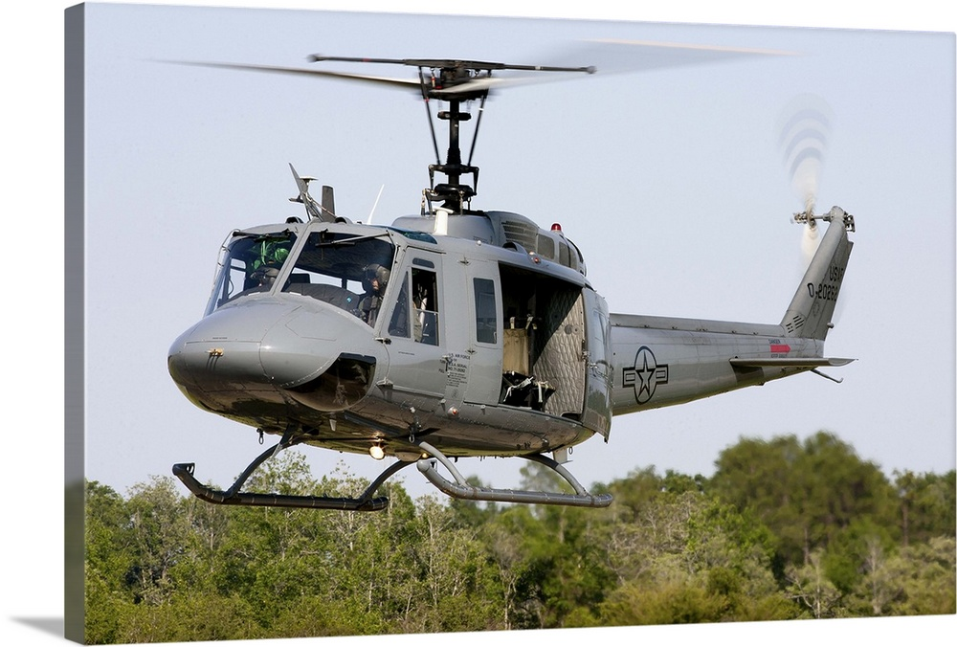
TH-1H Huey Trainer

Slide 57
Multi-Function Display: RE/RD Robins AFB – 411th SCMS
MD: | TH-1H
TMS: | N/A
Noun: | Multi-Function Display
NSN: | 5826-01-622-0442
P/N: | 261400-5
Forecasted Buy Price: | $94,608.65
Forecasted Repair Cost: | $35,703.06
AAC: | V
Unserv. Assets Avail: | Yes
QPA/APPL Rate: | 3 | 100%
AMC/AMSC: | 4 | R
RMC/RMSC: | 3 | R
Material: | Aluminum Alloy, Glass Display, Circuit Board
Dimensions: | 10 IN L X 10 IN W X 12 IN H X 20 LBS
Criticality Code: | X
Drawings Releasable: | No
Drawing #: | Not Available
Drawing Cage Code: | Not Available
T.O. Releasable: | No
T.O. #: | Not Available
Budget Code: | 8
Next Higher Asmbly: | Huey TH-1H Trainer
Out Year Requirements: BUY
FY24: | 0 | FY25: | 0 | FY26: | 0 | FY27: | 0 | FY28: | 0
Out Year Requirements: REPAIR
FY24: | 18 | FY25: | 18 | FY26: | 18 | FY27: | 18 | FY28: | 18
EDL: | Not Available |  |  |  |  | RDL: | Not Available
Tinker | 8/10/2023 |  |  |  |  | Robins | ------
Hill | ------ |  |  |  |  | Virtual | ------
Comments
Function: Presents primary flight and navigation information critical for conducting flight operations
Constraint: LCD screen obsolete – may require Reverse Engineering
Deliverables: Complete technical data package including all repair processes of F3I replacement

Slide 58
Multi-Function Display: RE/RD Robins AFB – 411th SCMS
Additional Comments
Note: Quantity 3 per aircraft
White Papers: Interested vendors should submit a White Paper to 429SCMS.SASPO.workflow@us.af.mil
Technical Discussions: RSVP for Technical Discussions
If you would like to participate in the Technical Discussion on:
September 7, 2023, 9:00AM-10:00AM CDT
provide the following, NLT
August 30, 2023
429SCMS.SASPO.Workflow@us.af.mil
-Company, -Address, -Name(s), -Email(s), -Phone,
-Your questions for Engineering, and
-Statement of Capabilities

Slide 59
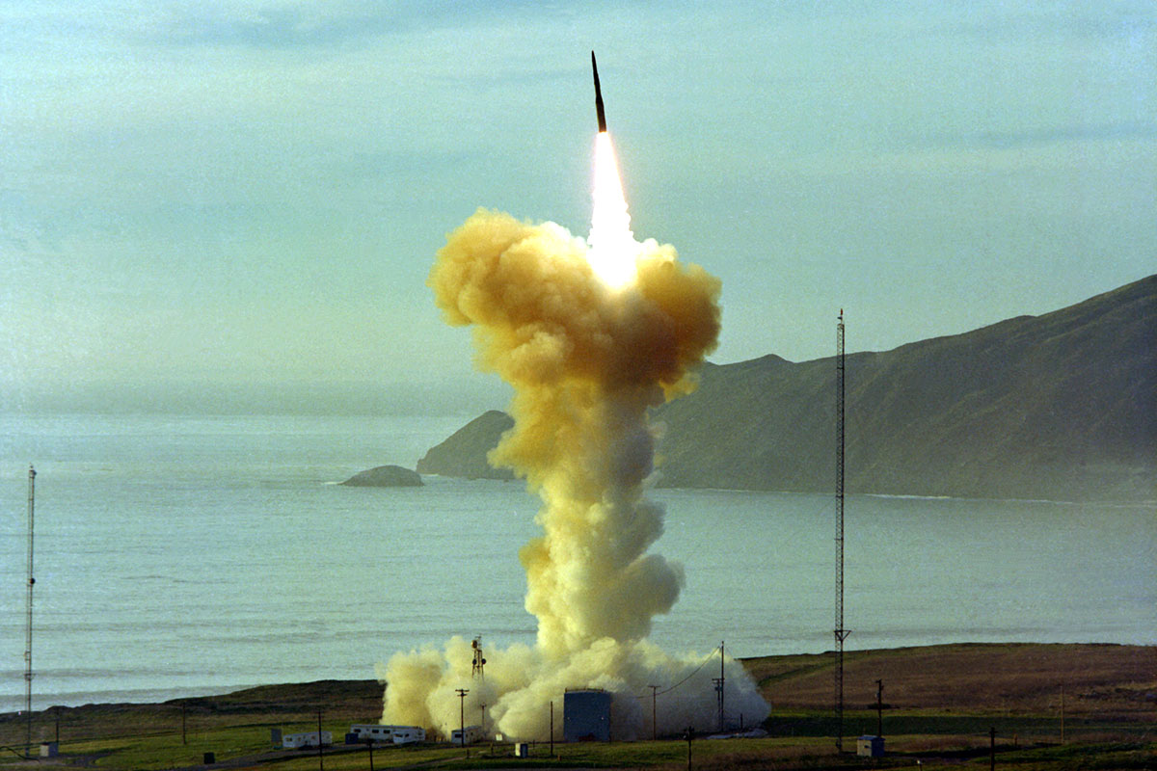
Intercontinental Ballistic Missile (ICBM)

Slide 60
Light Fixture Assembly: Market Research Hill AFB – 414 SCMS
MD: | ICBM
TMS: | N/A
Noun: | Light Fixture Assembly
NSN: | Not Stock Listed
P/N: | W001045
Forecasted Buy Price: | $500 - $2,500 (estimated range)
Forecasted Repair Cost: | N/A
AAC: | Not Available
Unserv. Assets Avail: | Not Available
QPA/APPL Rate: | Not Available | Not Available
AMC/AMSC: | Not Available | Not Available
RMC/RMSC: | N/A | N/A
Material: | Not Available
Dimensions: | Not Available
Criticality Code: | Not Available
Drawings Releasable: | Yes
Drawing #: | W001045
Drawing Cage Code: | 11530
T.O. Releasable: | No
T.O. #: | Not Available
Budget Code: | 9
Next Higher Asmbly: | Not Available
Out Year Requirements: BUY
FY24: | 3 | FY25: | 3 | FY26: | 3 | FY27: | 3 | FY28: | 3
Out Year Requirements: REPAIR
FY24: | 0 | FY25: | 0 | FY26: | 0 | FY27: | 0 | FY28: | 0
EDL: | Not Available |  |  |  |  | RDL: | Not Available
Tinker | 8/10/2023 |  |  |  |  | Robins | ------
Hill | ------ |  |  |  |  | Virtual | ------
Comments
Interested vendors should submit a Capabilities Statement to 429SCMS.SASPO.Workflow@us.af.mil
No Source Approval Request (SAR) Package required

Slide 61
Light Fixture Assembly: Market Research Hill AFB – 414 SCMS
Additional Comments
These Light Fixture Assemblies are no longer manufactured. All supplies have been consumed or disposed of, the remaining end items are being drawn in for a needed PNSSR for repair. More units will need to be manufactured to put assets on the shelves. More failures will occur due to the increased age of the components.

Slide 62
Cessna R172/7-41 and 150/T-51

Slide 63
Cessna R172/T-41 and 150/T-51 AF Trainers Support: New/Overhauled Mat. – Tinker AFB
Services Required: Seeking New and unused or overhauled material to support USAFA Cessna Trainer Program. This program is supported by a Contractor Logistics Support (CLS) contract.
Scope: Some parts have long mean time between failure with current parts shortage issues due to obsolescence.
Technical Requirements:
Valid 8130-3 tags with 100% traceability to the OEM
Interested & qualified vendors should submit their requests/capabilities to the SASPO workflow: 429SCMS.SASPO.Workflow@us.af.mil
Supplying Warfighter Dominance

Slide 64
Cessna R172/T-41 and 150/T-51 AF Trainers Support: New/Overhauled Mat. – Tinker AFB
0541122-2 –Gear Saddle 2 0541122-1 – Gear Saddle
069-1024-31 – KX-155 Radio S1189-2 – Baggage Door Latch
0592300-11 – Left Hand Fuel Tank 9705-0006-101 – Strobe Relay
0426519-2 – Right Hand Fuel Tank T51 0592300-10 – Right Hand Fuel Tank
00512017-01 – Radio Shelf 0513241-201 – Shock Assy Inst. Panel
0513241-3 – Inst. Panel Stiffener 066-1072-00 – Auto. Direction Finder
0513241-4 – Inst. Panel Bracket 066-1088-00 – Dist. Meas. Equipment
1556026-1 – Elec. Fuel Pump 0716606-4 – Fuel Arm Assembly
0511258-2 – Pilot Side Door Latch Assy

